Slide 1
Home Insurance dataset case study
Théo Chavannes

Slide 2
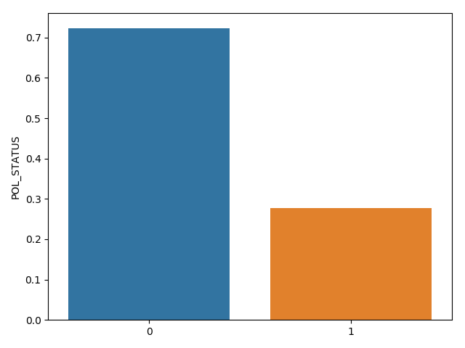
Introduction
This is a Home Insurance dataset including police's years between 2007 and 2012. Each police includes some significant characteristics of polices, building's characteristics, the zone, the privileges, the faults, some risk indicators and so on.
Goal: predict future lapsed cases

Slide 3
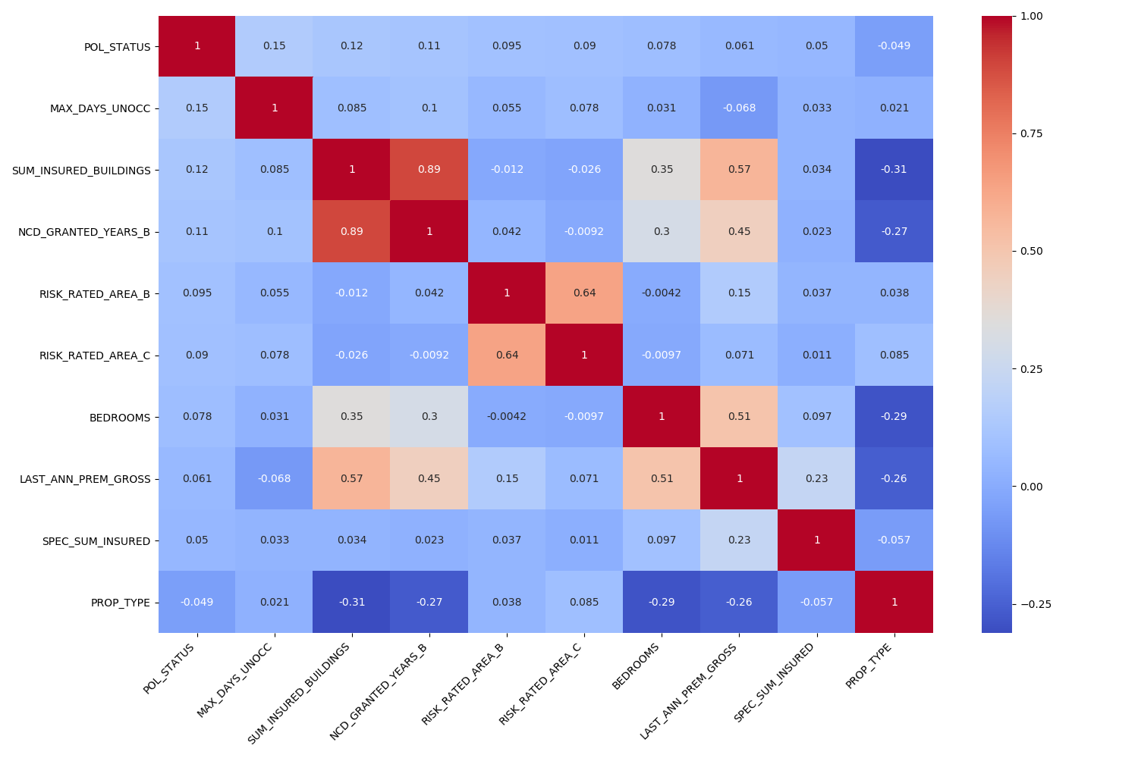
Data analysis

Slide 4
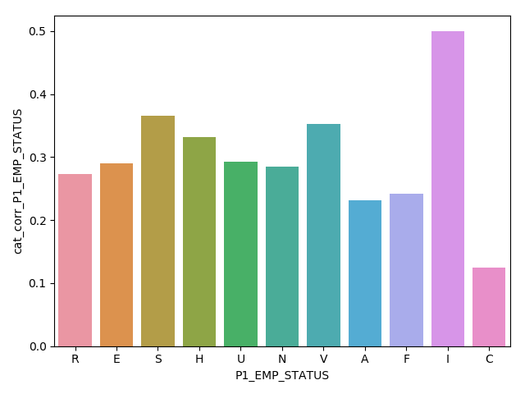
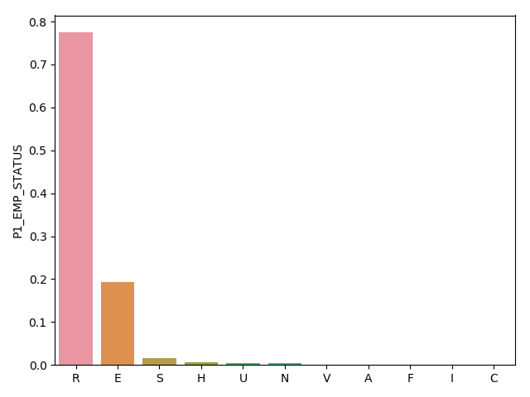
Data analysis: multi valued categorical features

Slide 5
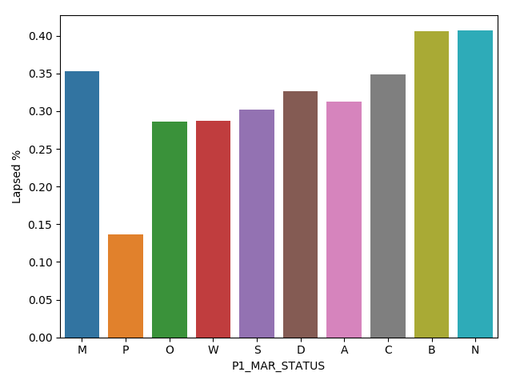
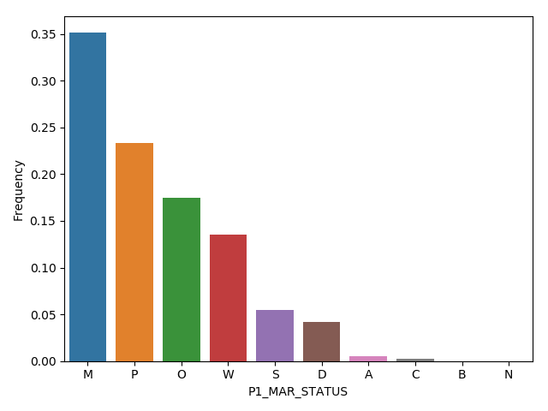

Slide 6
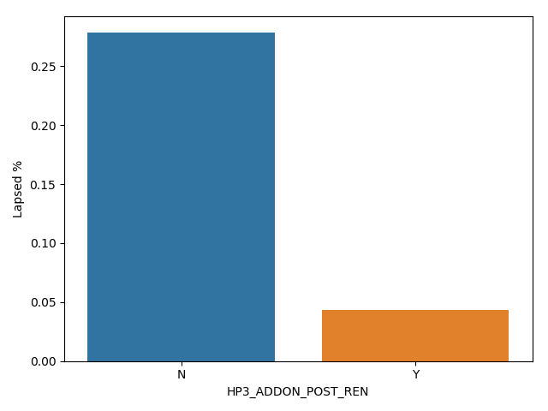
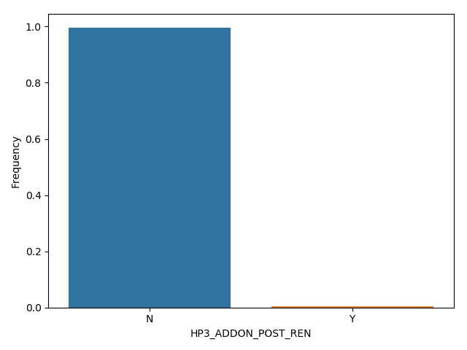

Slide 7
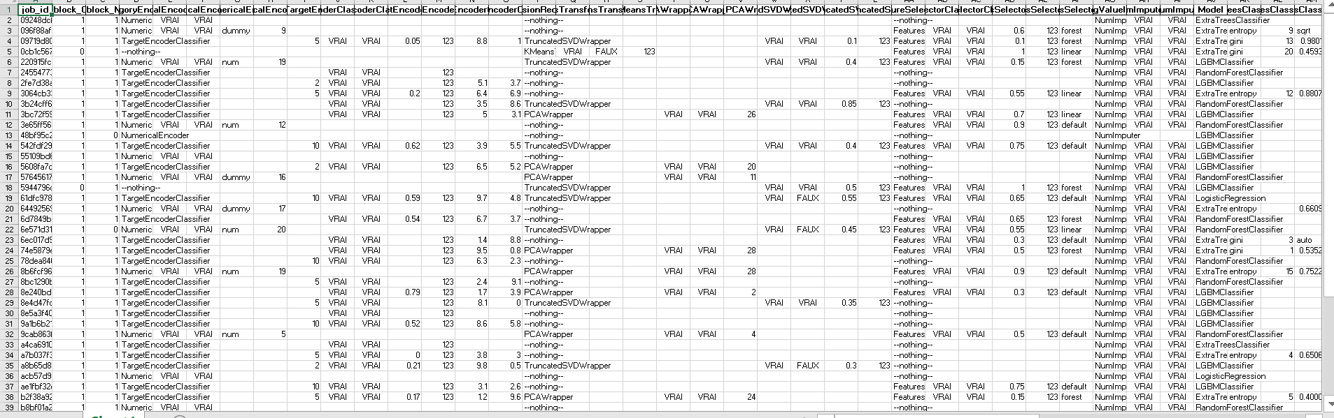
AUTOML, final model & results
Metrics = roc_auc; baseline_score: 0.58; best_model_score (lightgbm): 0.77

Slide 8
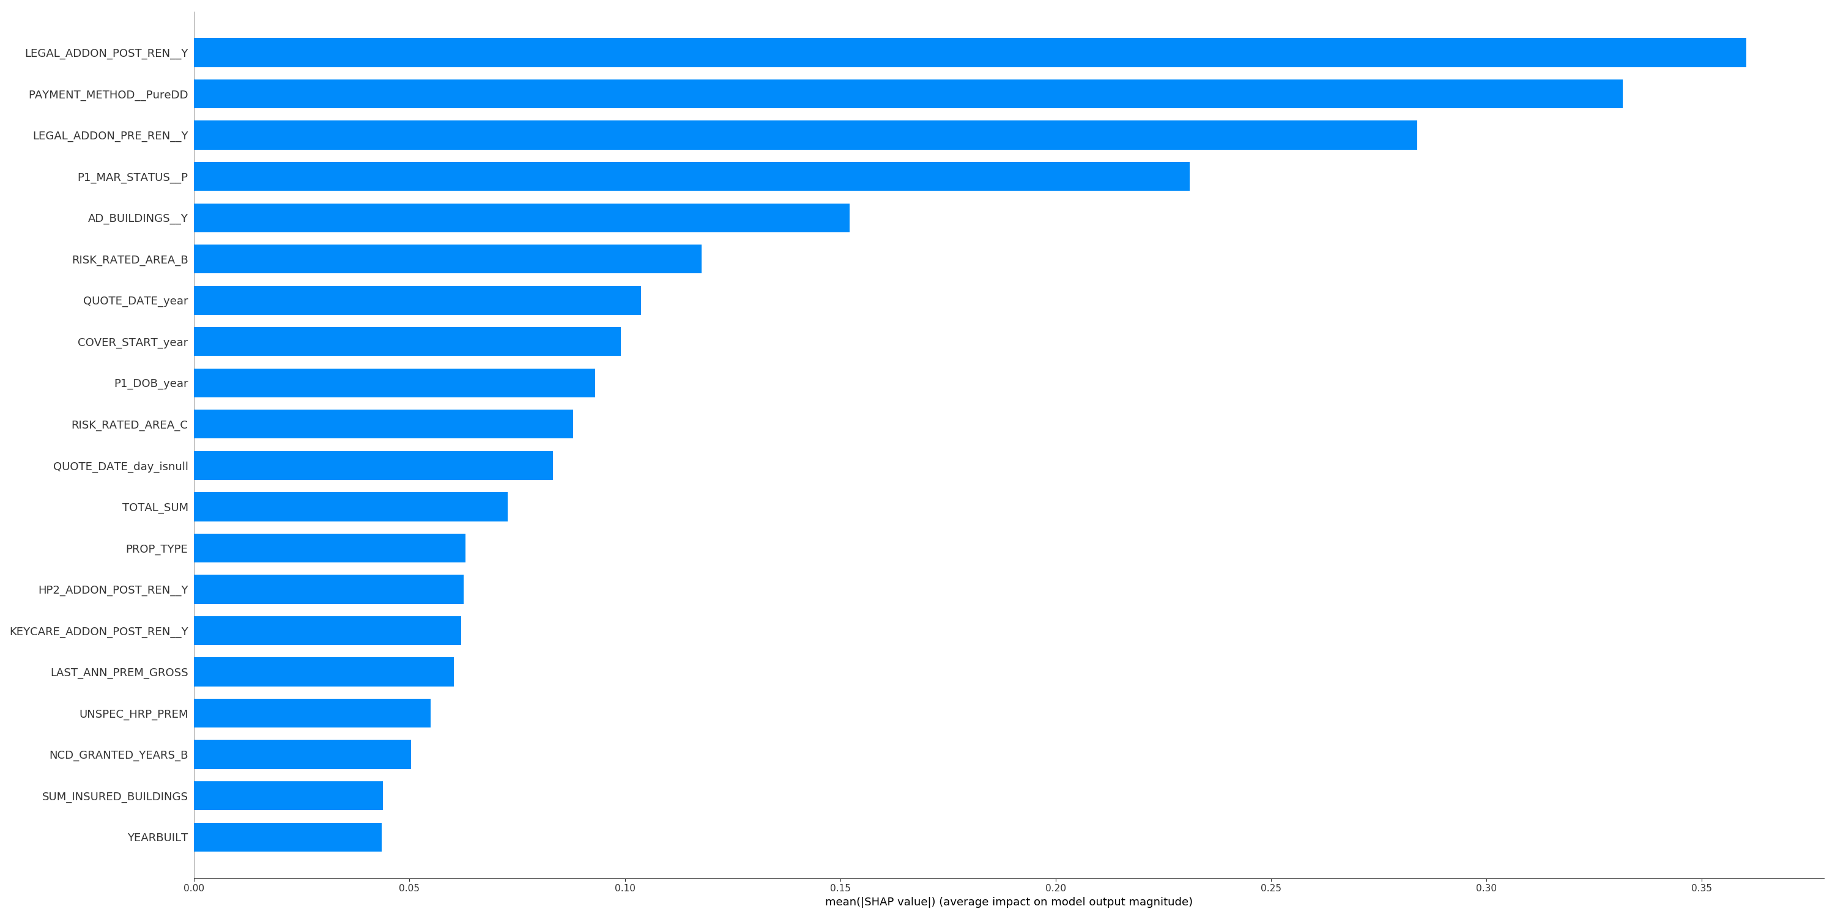
Features importances

Slide 9
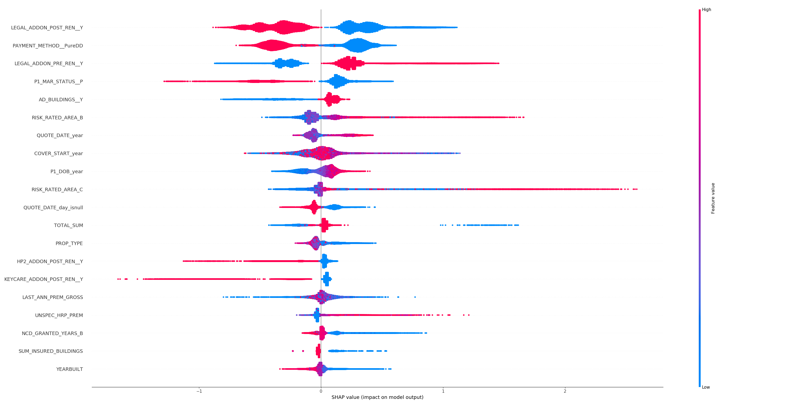
Shap plot

Slide 10
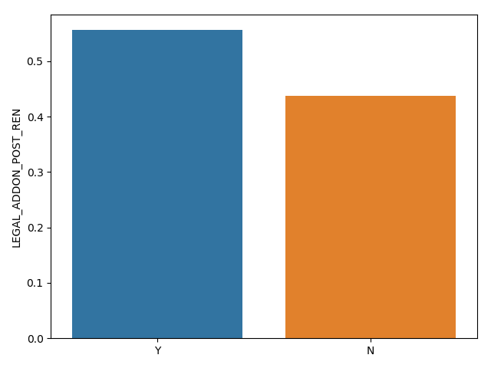
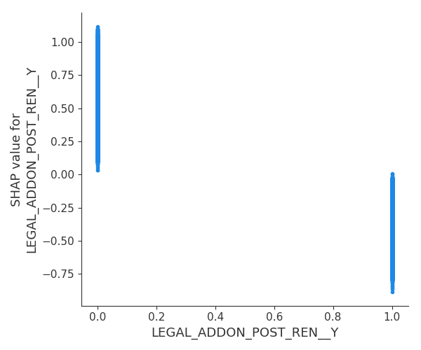
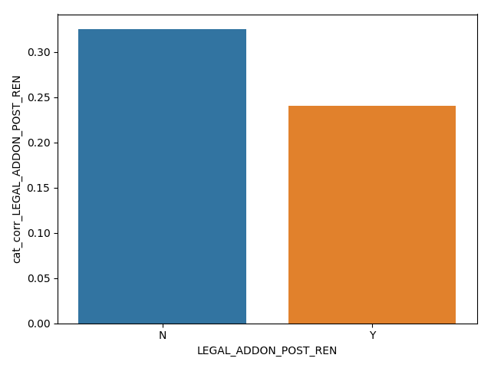
Dependence plots

Slide 11
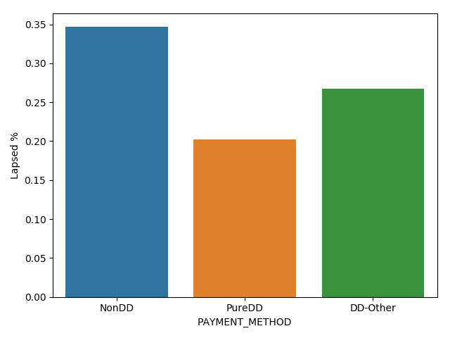
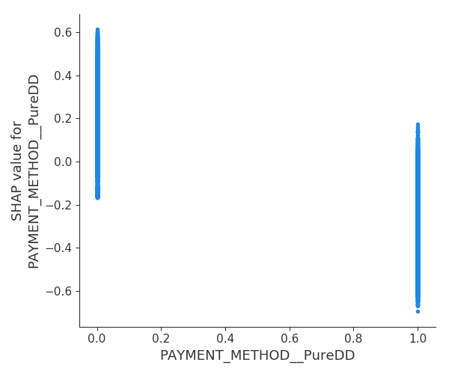
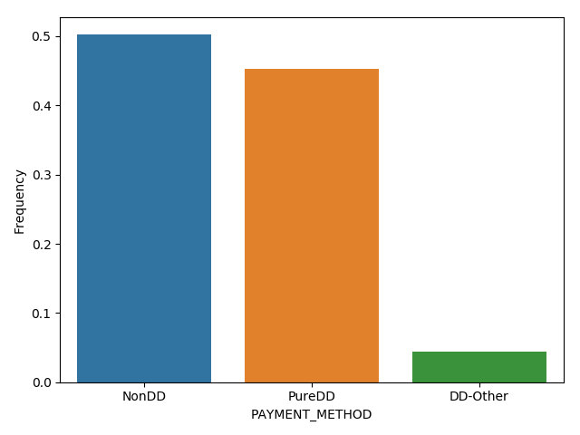
Dependence plots

Slide 12
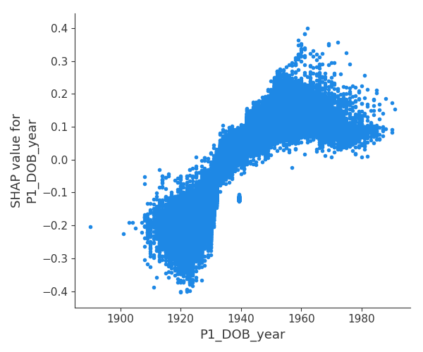
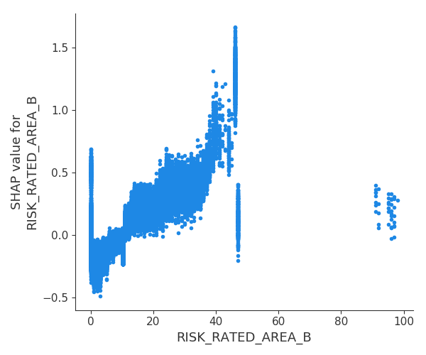
Dependence plots

Slide 13
Next steps
Check the different plots and investigate features which have some ”gaps” in the values taken, if possible interacting with business people, to be sure this is not some outliers in the data
Improve feature engineering
Tune lightgbm

Slide 14
Final model

Slide 15
Model explainability

Slide 16
Features importances

Slide 17
delivering the solution
Package
Code structure
Pickle of the model
Call json

Slide 18
Areas which you should pay particular attention to are;
• Data exploration: What are the most interesting features of the data set? What have you
considered and why have you made the decisions you have done?
• Modelling: What process did you follow when modelling retention? How have you designed
your model and what did you account for?
• What are your conclusions and what else would’ve been useful to know?

